Slide 1
Classification of hotels for Expedia.
Project in Artificial Intelligence - EDAN70

Slide 2
Introduction
Who we are.
Kaggle.com
Our main problem. Expedia
Warmup - Digit recognizer.
Random Forest Classifier.
SVM.
Expedia and workflow.
Conclusions.

Slide 3
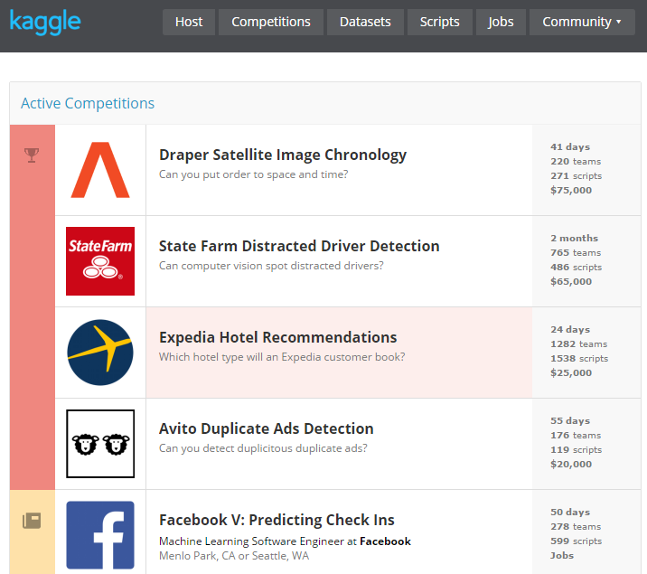
Kaggle.com
Users from all over the world compete to produce the best machine learning models.
Submissions, Scripts, Leaderboards.

Slide 4
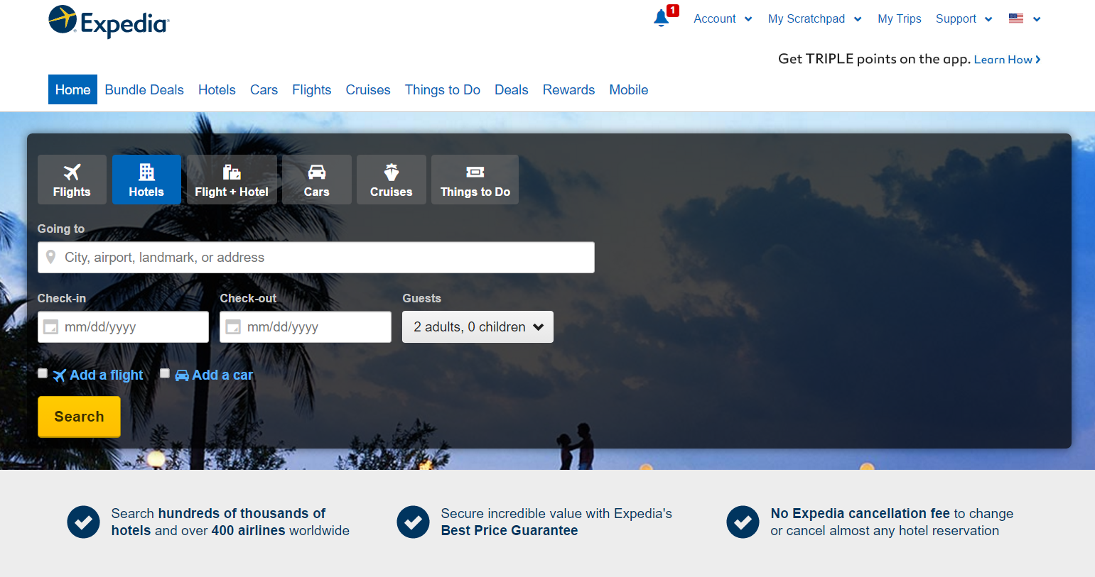
Expedia
The problem – Expedia.
< $60 / night
Central

Slide 5
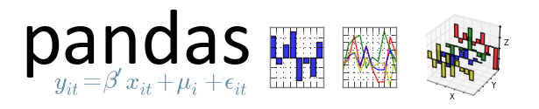


Tools
Python 64-bit
Alot of RAM
Pandas – parsing data into data structures
NumPy – scientific computing package
Scikit learn – Machine Learning library, built on SciPy, NumPy and matplotlib

Slide 6
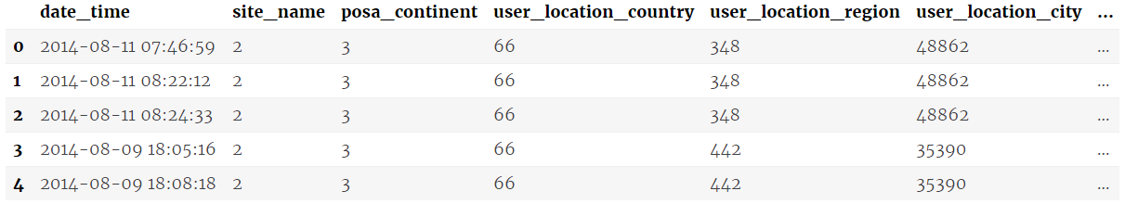
Expedia - dataset
24 column in training
22 column in testing (no is_booking, no hotel_cluster)
Most of the columns are integers or floats
Output hotel cluster ID integer range from 1-99

Slide 7


Expedia - workflow
Understanding dataset
srch_destination_type_id, hotel_continent, hotel_country, and hotel_market
srch_ci srch_co are filled with dates
srch_adults_cnt, srch_children_cnt, and srch_rm_cnt is number of guests and rooms
site_name – Expedia point of sale (Expedia.com, Expedia.co.uk, ...)
Add a flight maps to the is_package field
posa_continent – ID of continent associated with site_name

Slide 8
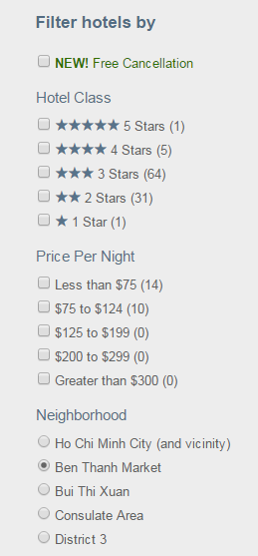
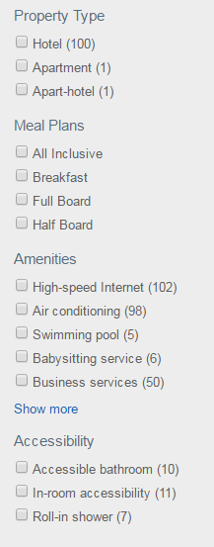
Expedia – Hotel Clusters
{
}
,
,
,
…
Useful! Expedia can much quickier
at an earlier stage filter the hotels
< $60 / night
Central

Slide 9
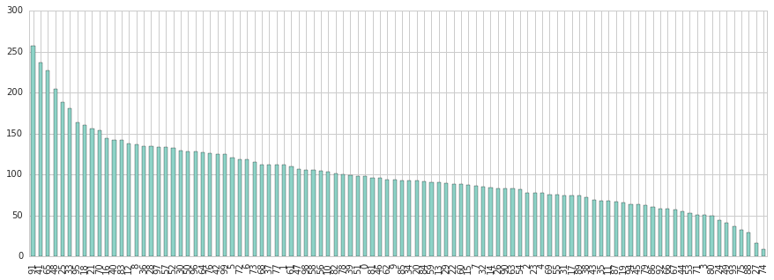
Expedia – most frequent hotel clusters

Slide 10
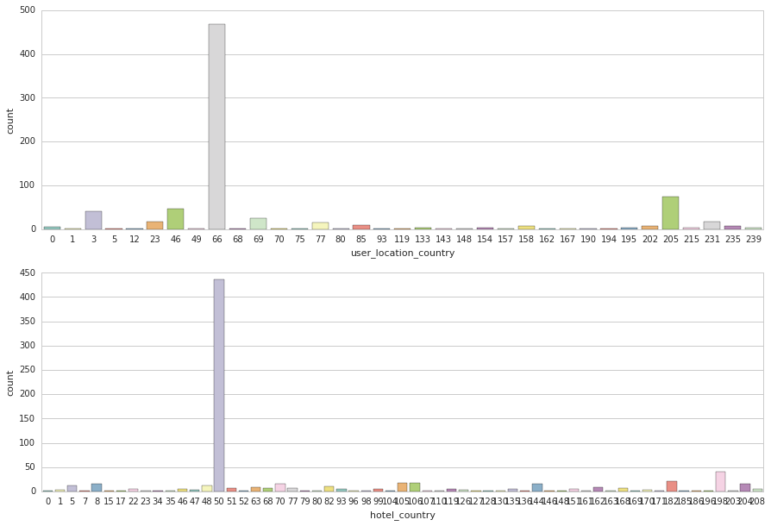
Expedia – examining features
What are the most countries the customer travel from/to?

Slide 11
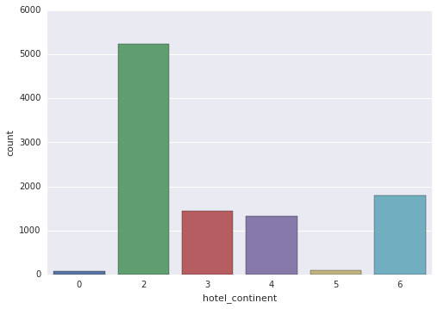
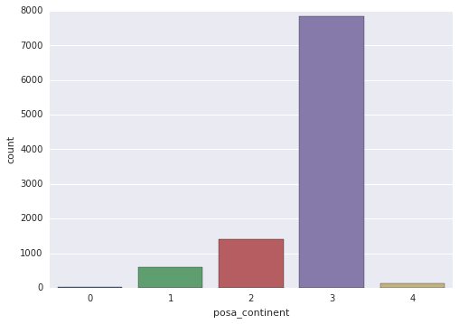
Preffered destination continent
Continent where the search was made

Slide 12
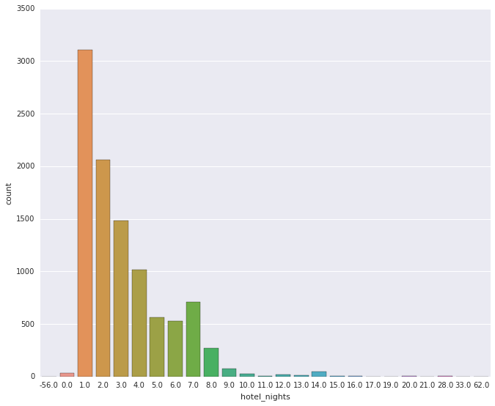
Nights of stay

Slide 13
Random Forest Classifier
Supervised learning classifier – Bagging methods
Random sub-samples
Generates decision trees on each sub-sample
[BILD sub-samples, decision trees]

Slide 14
Random Forest Classifier
Sum all the decision trees
Mistakes are taken care of
The classifier avoids over-fitting

Slide 15
Random Forest Classifier
Why does Random Forest work?
1. Most tree provide correct prediction for most part of the data.
2. Tree make mistake at different place.
[bild över träd som korrigeras]

Slide 16
SVM
SVM. Varför vi försökte använda den i Expedia (men funkade inte).

Slide 17
Popular hotels

Slide 18
Leackage

Slide 19
Expedia - Conclusion

Slide 21
what problem have you tried to solve, with what method, what are the results, what is your conclusion

